Slide 1
Lead Scoring
Case Study
Submitted By:
Manvinder Singh
Mohit Seghal

Slide 2
Problem Statement
To build a model which assigns a lead score to each of the leads such that the customers with higher lead score have a higher conversion chance and the customers with lower lead score have a lower conversion chance.

Slide 3
Solution Approach
Built a logistic regression model to find the probability of conversion of each lead.

Slide 4
Data Cleaning & EDA
Removed the columns which had high null percentage (more than 45%)
Removed highly skewed columns
Combined the values which had very less contribution in their field.
Imputed the missing numerical fields with the median value

Slide 5
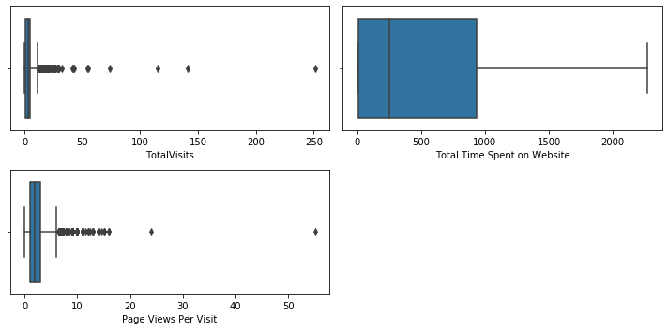
Outliers

Slide 6
One Hot Encoding
Created Dummy variables for the categorical fields
Dropped the dummy variable with least business importance
Dropped the original categorical fields

Slide 7
Preparation for Logistic Regression
Split the data into train and test data with 70-30 split ratio
Scaled the features using the Standard Scaler
Removed the correlated fields to remove the multi-collinearity

Slide 8
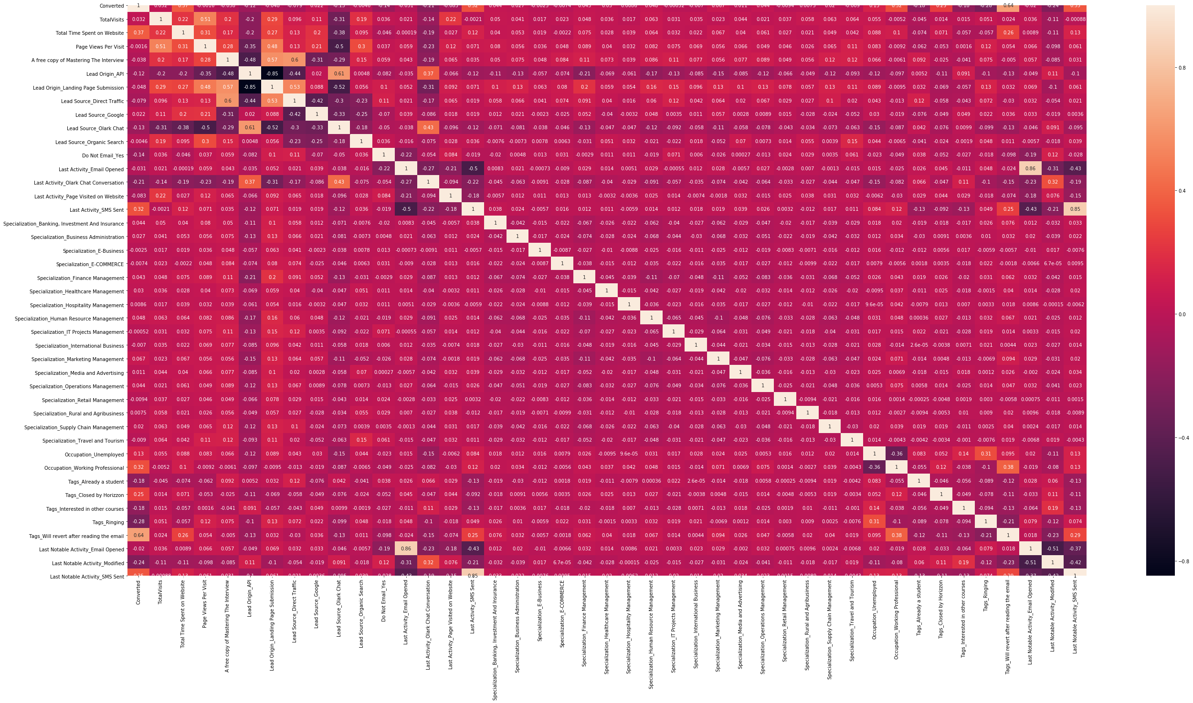

Slide 9
Feature Elimination
Used the RFE approach for feature elimination
Selected columns after RFE are:
Total Time Spent on Website - Tags_Interested in other courses
Lead Source_Direct Traffic - Tags_Will revert after reading the email
Lead Source_Google - Last Notable Activity_SMS Sent
Lead Source_Olark Chat - Tags_Ringing
Lead Source_Organic Search
Do Not Email_Yes
Occupation_Unemployed
Occupation_Working Professional

Slide 10
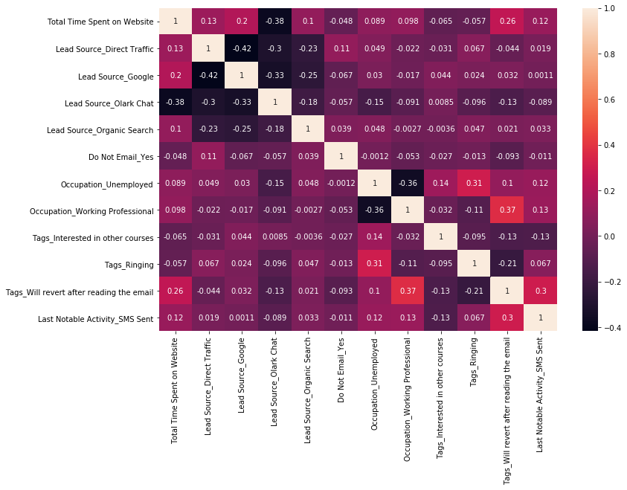

Slide 11
Manual Feature Elimination
Removed the following features based on correlation, business importance and VIF:
Occupation_Working Professional
Lead Source_Google
Lead Source_Olark Chat

Slide 12
Final Model
Fields and their coefficient in the final model are:
Total Time Spent on Website : 0.8316
Lead Source_Direct Traffic : -0.8834
Lead Source_Organic Search : -0.7659
Do Not Email_Yes : -1.3356
Occupation_Unemployed : 1.0018
Tags_Interested in other courses : -3.1007
Tags_Ringing : -3.6890
Tags_Will revert after reading the email : 4.0046
Last Notable Activity_SMS Sent : 1.8451

Slide 13
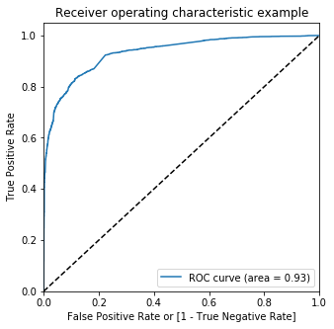
ROC Curve

Slide 14
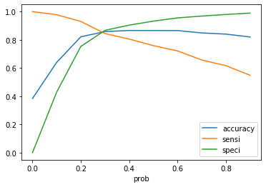
Optimal Cutoff Point

Slide 15
Training Data Evaluation
Confusion Matrix:
 |  | Predicted
Actual |  | Converted | Not Converted
 | Converted | 2097 | 387
 | Not Converted | 529 | 3455

Slide 16
Training Data Evaluation
Sensitivity : 84.42%
Specificity : 86.72%
False Positive Rate : 13.28%
Positive Predictive Value : 79.85%
Negative Predictive Value : 89.92%
Overall Model accuracy is 85.83%

Slide 17
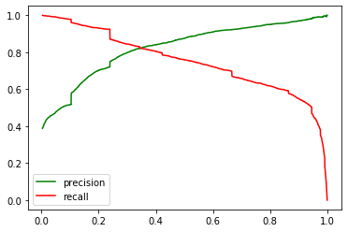
Precision and Recall Tradeoff
From the curve above, 0.38 is the optimum point to take it as a cutoff probability.

Slide 18
Test Data Evaluation
Confusion Matrix:
 |  | Predicted
Actual |  | Converted | Not Converted
 | Converted | 857 | 220
 | Not Converted | 152 | 1583

Slide 19
Test Data Evaluation
Sensitivity : 84.42%
Specificity : 86.72%
False Positive Rate : 13.27%
Positive Predictive Value : 89.92%
Negative Predictive Value : 83.87%
Overall Model accuracy is 86.61%

Slide 20
Test Data Evaluation
Precision Score : 83.88%
Recall Score : 81.15%
F1 Score : 82.89%

Slide 21
Conclusion
We have built a logistic regression model which provides the Lead Score to each lead.
Higher the Lead Score higher the probability of conversion for the lead
The cut off Lead Score is 38.
We can change the cut off lead based on the business requirement in different time intervals.

